Slide 1
TOPIC:-
TED TALKS VIEW
PREDICTION
Presented by : A . VIDHYA
221FA14120
3BI-B

Slide 2
Presentation Outline:
Industry overview
Problem Statement
Project Objective
Exploring the dataset
plan of action
Step by step of thought process and approach
EDA CHARTS
Histogram of data
Correlation matrix
Boxplot , linear regression plot , scatter plot’s
Data Processing
Data splitting AND MODELS
IMPROVEMENTS DUE TO HYPERPARAMETER TUNING
RESULT
Conclusion

Slide 3
Industry overview :
TED Talks have become a significant part of the global content-sharing and thought-leadership ecosystem, featuring presentations on a wide range of topics from science and technology to art, culture, and personal development. Predicting views on TED Talks has grown in relevance as content creators, marketers, data scientists, and platform administrators seek insights into what drives audience engagement and popularity.

Slide 4
Business Problem Statement:
Key Business Problem: TED needs a reliable predictive model that can forecast the number of views a talk will receive, based on a combination of factors such as topic, speaker popularity, title, description, and length of the talk. Without this capability, TED is missing out on opportunities to:
Optimize content curation for broader audience appeal
Increase engagement and viewership across platforms
Enhance sponsorship and monetization efforts through more accurate ad targeting and partnership alignment
Improve audience personalization and recommendations

Slide 5
Problem objectives:-
Accurately Predict Viewership: Build a machine learning model that predicts the number of views a TED Talk is likely to receive, considering key factors such as topic relevance, speaker influence, and talk characteristics.
Content Strategy Optimization: Provide TED with data-driven insights to curate and prioritize talks that align with trending topics and audience preferences, maximizing viewership.
Improved Audience Targeting: Enhance audience personalization by recommending talks based on predicted popularity and individual user preferences, improving user experience.

Slide 6
Marketing and Monetization: Support marketing teams by identifying high-potential talks for promotional campaigns and sponsorships, thereby maximizing advertising revenue and sponsorship opportunities.
Increase Engagement: Use predictive insights to boost overall platform engagement by tailoring content delivery to match audience trends and preferences.

Slide 7
Data Sets:
1. Talk Details:
Title: The title of the talk.
Description: A brief overview or abstract of the talk.
Topic/Tags: The main themes or topics of the talk, often listed as tags (e.g., technology, education, innovation).
Duration: Length of the talk in seconds or minutes.
Transcript: The text of the entire talk, which can be used for natural language processing (NLP) to assess content relevance and sentiment.
2. Speaker Information:
Speaker Name: Name of the person giving the talk.
Speaker Occupation: Job title or role of the speaker.
Speaker Popularity: Historical data on the speaker's previous talks (if applicable) and their social media presence.

Slide 8
3. Talk Metadata:
Published Date: The date the talk was published online.
Event: The TED conference or event where the talk was delivered.
Number of Languages: Number of languages the talk has been translated into.
4. Engagement Metrics:
Number of Views: The target variable – the number of views the talk received.
Number of Likes/Shares: Social media engagement data (if available).
Comments: The number of comments made on the video.
5. Additional Features:
Video Quality: Resolution and production quality of the video (high, medium, low).
Sentiment Analysis: Sentiment score of the talk's transcript, extracted through text analysis.
Category: Whether the talk is classified under certain TED categories (e.g., “TEDx,” “TEDWomen,” etc.).

Slide 9
Plan of Action:
Data Understanding & Exploration
Data Preprocessing
Feature Selection
Model Building
Model Evaluation
Model Interpretation and Insights
Model Deployment
Continuous Monitoring and Model Updates

Slide 10
Step-by-step of thought process & approach
1. Data Understanding & Exploration:
Objective: Understand the dataset, ensure data completeness, and get a high-level overview of the relationships between features and the target variable (number of views).
Steps:
Load the dataset and inspect its
structure (features and rows).
Check for missing or inconsistent data (null values, duplicates).
Perform exploratory data analysis (EDA) to identify trends, outliers, and distributions of key features (e.g., views, speaker popularity, topic categories).

Slide 11
2. Data Preprocessing:
Objective: Clean and preprocess the data to prepare it for modeling.
Steps:
Handling Missing Values: Impute or remove missing data.
Feature Engineering: Create new features based on existing ones (e.g., sentiment score from talk transcript, popular vs. niche topics).
Text Preprocessing: Use Natural Language Processing (NLP) techniques for text-based features (title, descriptn, transcript). This could involve:
Tokenization
Removing stop words
Word embeddings or TF-IDF to iocapture content meaning

Slide 12
Categorical Encoding: Convert categorical features (e.g., speaker occupation, tags) into numerical representations (e.g., one-hot encoding).
Scaling: Scale continuous variables (e.g., duration, number of comments) to ensure uniformity.
3. Feature Selection:
Objective: Identify the most relevant features for predicting views.
Steps:
Use correlation analysis to check which features are highly correlated with the target variable (views).
Perform dimensionality reduction techniques, such as PCA (Principal Component Analysis), to simplify the feature space while retaining key information.
Apply feature selection algorithms, like recursive feature elimination (RFE), to further narrow down important predictors.

Slide 13
4. Model Building:
Objective: Develop a predictive model to estimate TED Talk views.
Steps:
Split the Dataset: Divide the dataset into training and testing sets (e.g., 80% training, 20% testing).
Model Selection: Experiment with different machine learning algorithms:
Linear Regression: For baseline performance.
Random Forest Regression: To capture non-linear relationships between features and views.
Gradient Boosting (XGBoost, LightGBM): For high-performance, optimized predictions.
Deep Learning (Neural Networks): If the dataset is large enough and requires capturing complex interactions.

Slide 14
Cross-Validation: Use k-fold cross-validation to ensure model stability and prevent overfitting.
Hyperparameter Tuning: Perform grid search or random search to optimize the model's hyperparameters (e.g., learning rate, number of trees).
5. Model Evaluation:
Objective: Evaluate the performance of the model using appropriate metrics.
Steps:
Measure the performance of the model using metrics such as:
R-squared (R²): To understand how much variance in the views is explained by the model.
Mean Absolute Error (MAE): To measure the average magnitude of the errors in predictions.
Root Mean Squared Error (RMSE): To emphasize larger errors in prediction.
Compare performance across different models and choose the best one.

Slide 15
6.Model Interpretation and Insights:
Objective: Provide actionable insights from the model’s output.
Steps:
Analyze feature importance to understand which factors contribute the most to view prediction (e.g., speaker popularity, topic tags, talk duration).
Interpret the results to guide business decisions, such as what topics or speakers are likely to generate high engagement.
7. Model Deployment:
Objective: Implement the model in a real-world environment where it can predict views for new TED Talks.
Steps:
Create an API or integrate the model into TED's content management system for automated view predictions.
Set up a dashboard to visualize predictions and track actual view counts over time.

Slide 16
8. Continuous Monitoring and Model Updates:
Objective: Ensure that the model remains accurate and up-to-date.
Steps:
Monitor model performance using real-time data.
Retrain the model periodically with new TED Talks data to capture evolving trends.
Adjust the model for seasonality, emerging trends, or significant content changes.

Slide 17
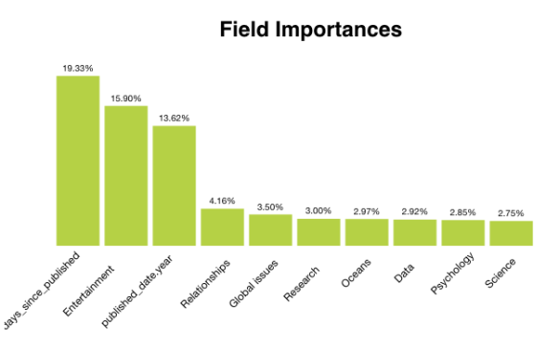
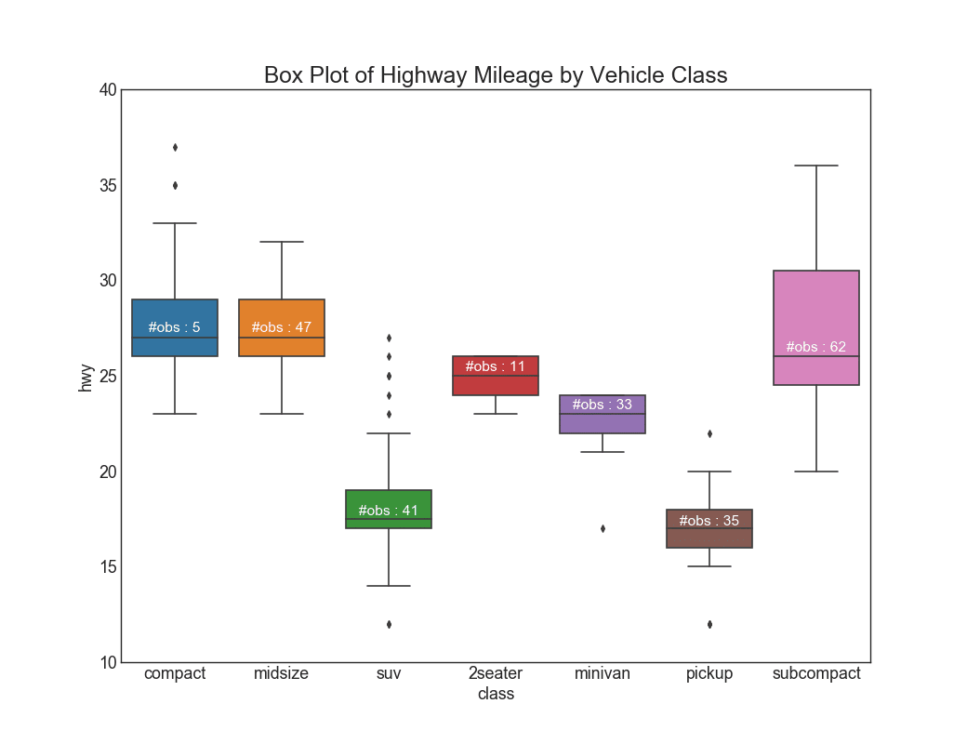
EDA charts

Slide 18
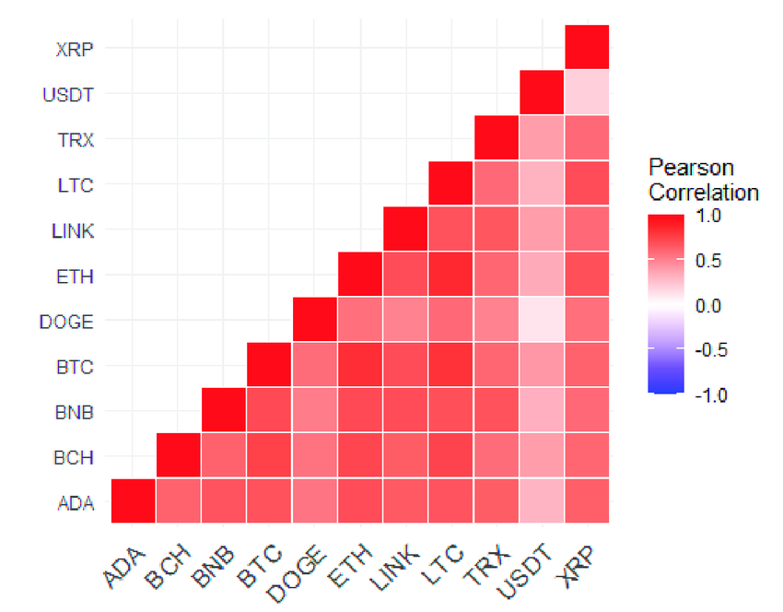
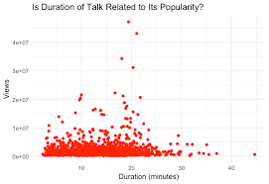

Slide 19
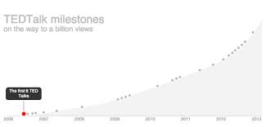

Slide 20
data preprocessing methods
Data Wrangling
Data wrangling (or data cleaning) is the process of preparing raw data into a usable format. It involves handling missing values, removing inconsistencies, and correcting data errors.
Steps Involved:
a. Handling Missing Data:
Objective: Ensure that missing values do not disrupt the prediction model.
Approach:
Dropping missing values: If certain rows have missing data in non-critical columns, we can drop them.
Imputing missing values: For numerical features (e.g., "talk duration"), missing values can be replaced with the median or mean. For categorical features (e.g., "topic tags"), the mode or a special "unknown" category can be used.

Slide 21
b. Handling Duplicates:
Objective: Ensure there are no duplicate entries in the dataset.
Approach: Remove any duplicate rows to avoid data redundancy, which can skew the model’s learning.
c. Correcting Inconsistent Data:
Objective: Fix inconsistencies in categorical variables (e.g., inconsistent spelling of speaker names or topic tags).
Approach: Standardize spelling, capitalization, and formatting for categorical columns like "speaker name," "topic," and "event."
d. Outlier Detection and Treatment:
Objective: Identify outliers in numerical features like "views" and "duration" that might disproportionately affect the model.
Approach:Use boxplots or z-scores to detect outliers.
Depending on the analysis, outliers can be capped, transformed, or removed if they are anomalies.

Slide 22
2. Feature Engineering
Feature engineering is the process of creating new features or transforming existing ones to improve the predictive power of the model. For TED Talks view prediction, this step is vital to extract useful information from the available data.
Steps Involved:
a. Date Features:
b. Text Preprocessing for NLP
c. Popularity Metrics
d. Audience Engagement Features
e. Feature Transformation
f. Categorical Encoding

Slide 23
Reasons for Data Splitting
Data splitting is a critical step in machine learning to ensure that the model is trained effectively and evaluated properly. It involves dividing the available dataset into subsets, typically training, validation, and testing sets. This helps to prevent overfitting and ensures that the model can generalize well to new, unseen data.
Typical Data Splitting Approach:
Training Set (70-80%): Used to train the model.
Testing Set (20-30%): Used to evaluate the model's performance.
Validation Set (Optional, 10-15%): Used for hyperparameter tuning and model selection.

Slide 24
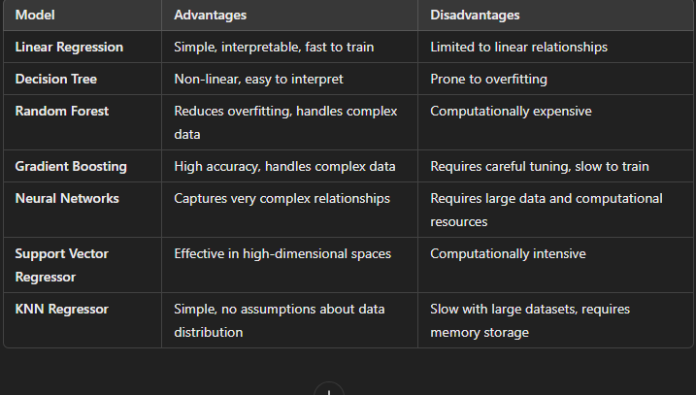
Models Used in TED Talks View Prediction
For predicting the number of views on TED Talks, a variety of machine learning models can be used, ranging from basic regression models to more complex ensemble methods.

Slide 25
Significant Improvements Due to Hyperparameter Tuning :-
Improvement in Model Accuracy
Reduction in Overfitting
Faster Convergence and Training Time
Improved Feature Importance and Interpretability
Better Control Over Bias-Variance Trade-off
Optimization of Resource Utilization
Hyperparameter tuning in TED Talks view prediction leads to significant improvements in:
Predictive accuracy: Better model performance on unseen data by reducing overfitting and improving generalization.
Training time: Faster convergence through careful tuning of learning rates and tree-building parameters.
Bias-variance trade-off: Tuning helps balance the bias-variance trade-off, producing a model that is neither too simple nor too complex, leading to better predictions.

Slide 26
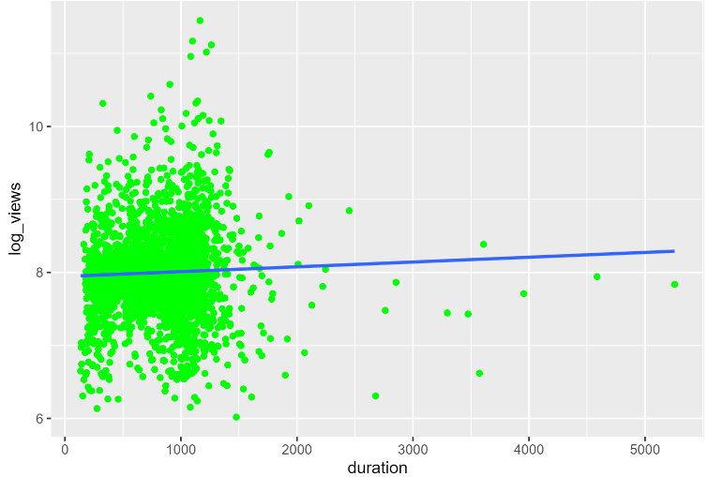
RESULT:-

Slide 27
Conclusion:
In conclusion, the TED Talks view prediction project has demonstrated the value of data-driven approaches in understanding and predicting audience engagement. By leveraging advanced modeling techniques and continuous improvement, TED can better align its content strategy with viewer interests and maximize the impact of its talks..

Slide 28
THANK YOU

